Slide 1
Flight Delay prediction
Machine Learning - Python

Slide 2
01
AGENDA
02
03
04
05
06
introduction
objective
Problem statement
Data exploration and variables selection
Comparison of model accuracy
conclusion

Slide 3
INtroduction
Flight delays cause airline carriers millions of dollars and inconveniences passengers, resulting in a loss of demand
Airline companies add additional flights during the holiday season or before starting of any festival for better service.
The flight status depends on some factors like weather conditions, Destination, origin, distance etc.
Compare Classification and Regression models to predict flight status, avoid delays and ensure smooth running of flight operations

Slide 4
objectives
Evaluate the dependent variables.
Predict the flight status as accurately as possible using Naïve Bayes (NB) model, Classification and Regression Tree (CART) model, logistic Regression model.
Model training based on historical data.
Select the best model by comparing the results.

Slide 5
Problem statement
Flight delay is a major issue in the aviation industry.
Delays in air travel can be very costly to both passengers and airlines.
It could make them late to their booked occasions or miss a corresponding flight.
Passengers may not generally be entitled for a refund when a postponement happens.

Slide 6
Data exploration

Slide 7
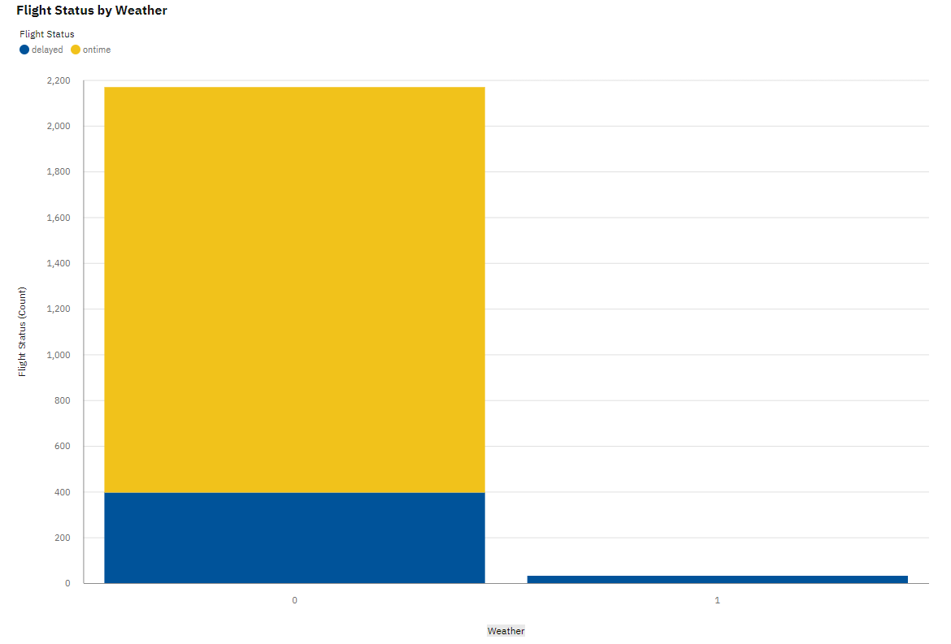
Flight Status based on weather conditions
Normal Weather
Bad weather
There is always a delay in flight when weather conditions are not normal.

Slide 8
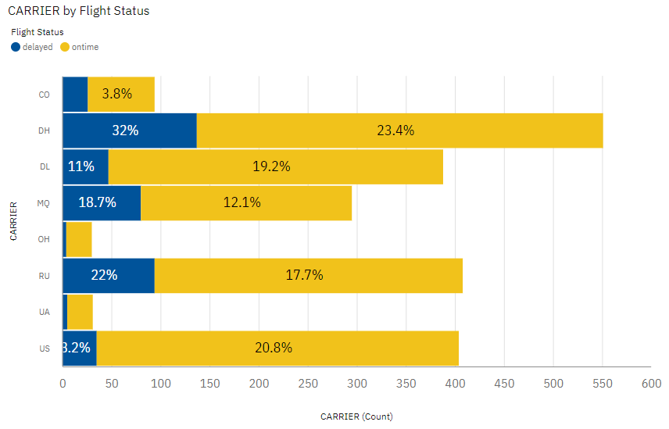
Flight delay for carriers
Some carriers are prone to having more delays than the others.

Slide 9
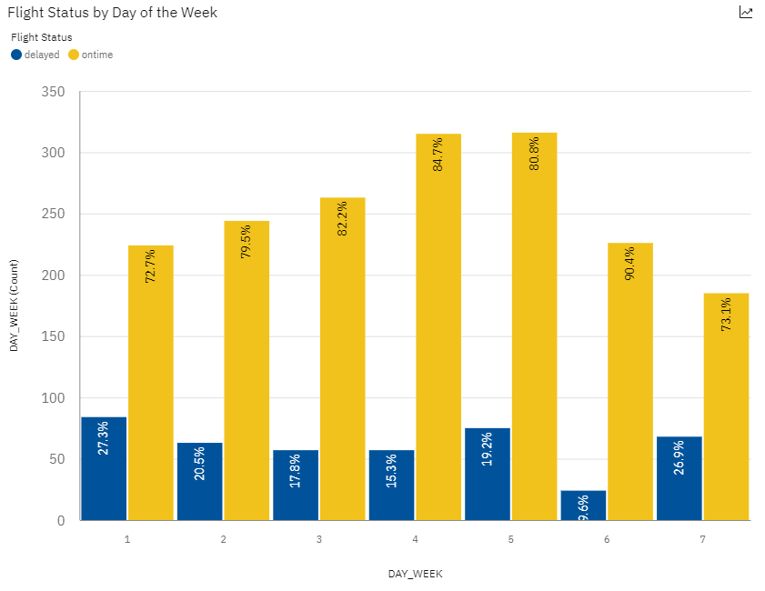
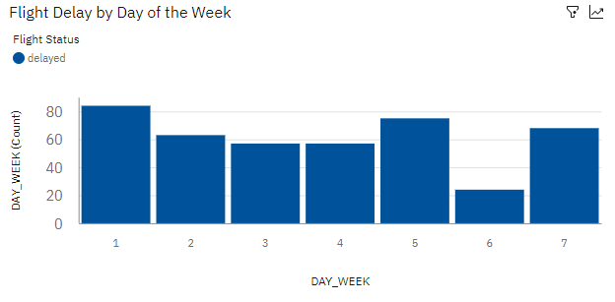
trend analysis for day of the week
There is no trend in on-time delay ratio for day of the week.

Slide 10
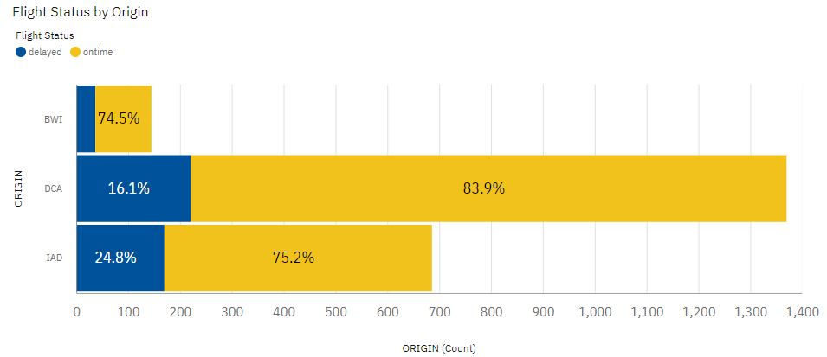
Analysis based on origin
There is not much difference in percentage count for delayed or ontime flights based on origin.

Slide 11
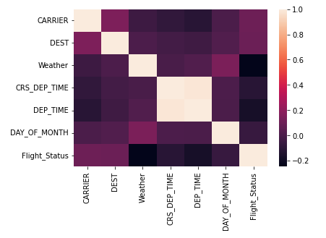
Variable selection
Correlation among the variables selected based on the analysis and trend depiction.

Slide 12
Comparison of model accuracy
Naïve Bayes model | Cart algorithm | Logistic Regression Model
88.83% | 87.30% | 89.05%
Generative model | Discriminative model | Discriminative model
Logistic Regression is observed to yield the highest accuracy in the prediction of flight delays

Slide 13
conclusion
Logistic Regression is the most appropriate model to predict flight delays
This model will alert carriers of probable flight delays
As next steps, further analysis can be done to predict various categories of delays:
Weather related
Maintenance related
Shortage of crew
Air traffic related

Slide 14
Thank you

